Slide 1
Radius

Slide 2
What does Radius do?
Network Protocol
Authentication, Authorisation & Management
Three main functions
Notes:
to authenticate users or devices before granting them access to a network,
to authorize those users or devices for certain network services and
to account for usage of those services.

Slide 3
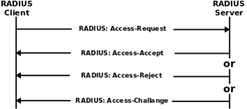
How Radius works
Client sends request to RAS
RAS sends Radius access request
Radius checks authentication
Radius authentication methods
Radius returns one of three response options

Slide 4
Radius with Kerberos
What is Kerberos?
Why Radius with Kerberos?

Slide 5
Plan of Approach
Install radius and kerberos
Make a keytab file
Edit the krb5 and users file
Setup TTLS with PAP
Modify inner-tunnel
http://www.eduroamus.org/node/45

